Slide 1


Home Screen 0
Game Plan
Start a new Game Plan
Review a saved Game Plan

Slide 2

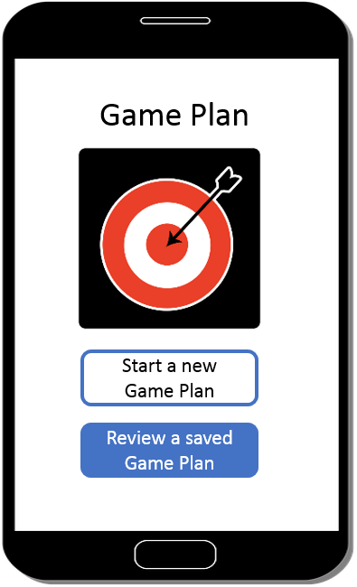


Home Screen 1
Home Screen 0
Saved Game Plan
Uncompleted Game Plans
Go to a restaurant with my friends.
Go to a concert.
Completed Game Plans
Go out shopping in the mall
Go to sporting events.

Slide 3
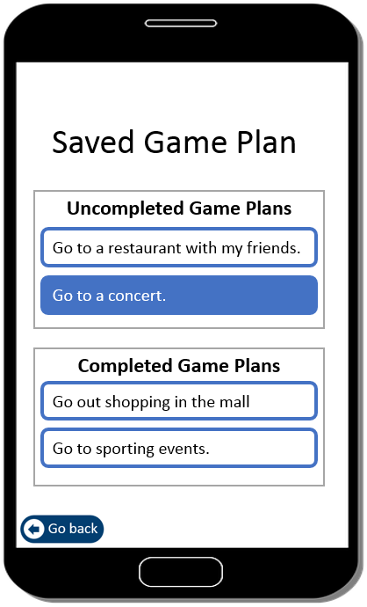




Home Screen 2
Home Screen 1
Ready for the next step
Goal
Plan step 1
You left off last time
Plan step 2

Slide 4
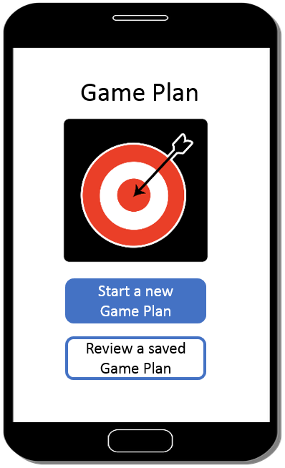
Transition screen
Transition screen (Goal)
Ready for the next step
Goal

Slide 5

Goal Screen 1
What activity would I like to do?
<Enter your goal here>
Click here if you need ideas for goals

Slide 6

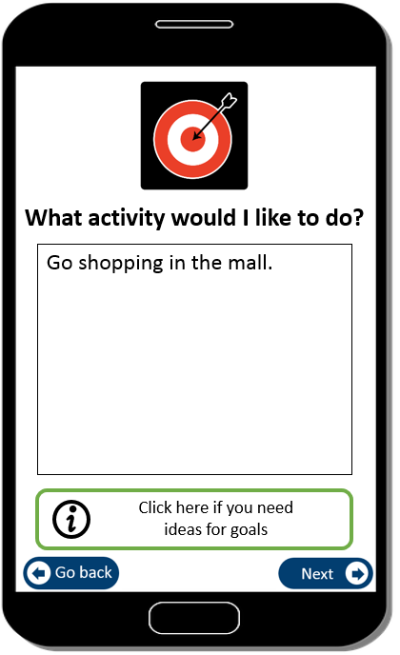
Goal Screen 2
Goal Screen 2
Goal Screen 1
What activity would I like to do?
What activity would I like to do?
Work, volunteer, or internships
School or college
>
>
School or college
Fun or leisure activities
>
Go to sporting events.
Fun or leisure activities
autofill
>
Go out shopping in a mall.
Taking care of myself
Go out to a restaurant.
>
>

Slide 7
Goal Screen 3
Goal Screen 1
Where will I do the activity?
Note: If users select “other”, then a text box would appear.
If users un-select “other”, the text box would disappear.
High school/Transition program
College or University
Other
Work
<Explain where I will do the activity>
In the community
At home
Other

Slide 8
Transition screen
Transition screen (Plan step 1)
Ready for the next step
Goal
Plan step 1

Slide 9

Environment screen 1
My goal is:
>
Go shopping in the mall.
What parts of the environment help me and make it hard for me?
Click on the parts of the environment that affect my goal.
Things
Inside places
People

Slide 10
Environment screen 1
My goal is:
>
Go shopping in the mall.
What parts of the environment help me and make it hard for me?
Click on the parts of the environment that affect my goal.
Things
Inside places
People

Slide 11




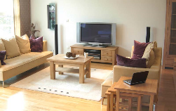
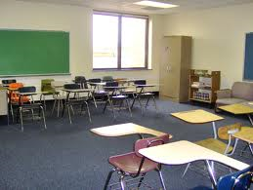
Environment screen 2-01
Environment screen 2-11
Do inside places help me or make it hard for me?
Pick help, hard or both
Help
Hard
Click here for the definition
Includes spaces inside buildings or other shelters and the size, shape, and layout of the space. Includes the spaces in-between rooms or floors.
Click here for the definition
Done
>

Slide 12
Environment screen 2-01
Environment screen 2-11
Do inside places help me or make it hard for me?
Pick help, hard or both
Help
Hard
<Explain how this makes it hard>
Click here for the definition
Done

Slide 13
Environment screen 2-01
Environment screen 2-11
Do inside places help me or make it hard for me?
Pick help, hard or both
Help
Hard
<Explain how this helps>
Crowded store, especially during lunch time. It was hard for me to move around.
Click here for the definition
Done

Slide 14
Environment screen 2-01
Environment screen 2-11
Do inside places help me or make it hard for me?
Pick help, hard or both
Help
Hard
It’s temperature in the inside place is comfortable for me.
Crowded store, especially during lunch time. It was hard for me to move around.
Click here for the definition
Done

Slide 15

Environment screen 1
My goal is:
>
Go shopping in the mall.
What parts of the environment help me and make it hard for me?
Click on the parts of the environment that affect my goal.
Things
Inside places
People

Slide 16
Environment Screen 3
My goal is:
>
Go shopping in the mall.
Pick one barrier to work on first.
Inside places
People
Entrances & Exits

Slide 17
Environment Screen 3
My goal is:
>
Go shopping in the mall.
Pick one barrier to work on first.
Inside places
People
Entrances & Exits
There’s no automatic door, so I can’t get into the mall.

Slide 18
Transition screen
Transition screen
(Plan step 2)
Ready for the next step
Goal
Plan step 1
Plan step 2

Slide 19

Strategy Screen 1
The barrier is:
>
Entrances & Exits
What strategy can I use to change the environment?
Click on one or more strategies
Plan ahead
Change spaces
Ask someone for help

Slide 20
Strategy screen 2-01
Strategy screen 2-06
How can I ask someone for help to reach my goal?
<Explain how to use the strategy>
Click here for the definition
Done

Slide 21
Strategy Screen 1
The barrier is:
>
Entrances & Exits
What strategy can I use to change the environment?
Click on one or more strategies
Plan ahead
Change spaces
Ask someone for help

Slide 22
Strategy screen 3
The barrier is:
>
Entrances & Exits
Pick one strategy to use first.
Plan ahead
Ask someone for help

Slide 23
Strategy screen 3
The barrier is:
>
Entrances & Exits
Pick one strategy to use first.
Plan ahead
Ask someone for help
Ask the staff to help me hold the front door.

Slide 24

Transition screen
Transition screen (Do)
Ready for the next step
Goal
Plan step 1
Plan step 2
Do

Slide 25



Do Screen 2
The strategy is:
>
Ask someone for help
Who do I talk to about making this change?
<Explain who to talk to>
Click skip if I don’t need to talk to anyone.
Skip

Slide 26





Do Screen 3
Advocating for Change Script
Advocating for Change Script
Write what to say to advocate for this goal. Click on each box to change the sentences.
The Americans with Disabilities Act says I have a right to be included in my community.
Hello, my name is David.
Scroll up and down to see the full script.
I need the staff to help me hold the door.
My goal is to go out shopping in a mall.
Thank you.
There’s no automatic door, so I can’t get into the mall.

Slide 27

Transition screen
Transition screen (Check)
Ready for the next step
Goal
Plan step 1
Plan step 2
Do
Check

Slide 28

Check Screen 1
My goal is:
>
Go shopping in the mall.
Can I do the activity now?
Yes
No

Slide 29
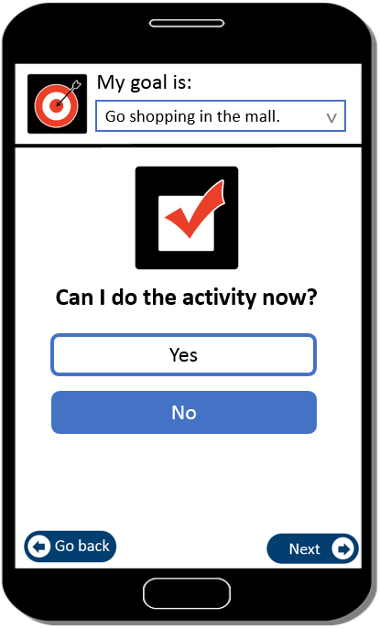



Check Screen 2
Check Screen 1
I still can’t do the activity because:
<Explain why I can’t do the activity>
I think I need to:
Pick a different barrier
Pick a different strategy

Slide 30
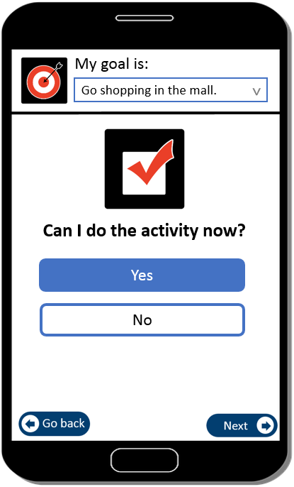
Check Screen 3
Check Screen 1
Congratulations! You reached your goal.
Click Next to review the Game Plan.

Slide 31
Review Screen 0
My Game Plan
My goal is:
>
Go shopping in the mall.
My barrier is:
>
Entrances & Exits
My strategy is:
>
Ask someone for help
I talk to:
>
Staff in the mall
Check

